Slide 1







ODOO IMPLEMENTAION
Date: April 28, 2025
Presenter: Group 1

Slide 2




AGENDA
AGENDA
Introduction
01
Purchasing Module
05
General Settings
02
CRM Module
06
Accounting Module
03
Sales Module
07
Inventory Module
04
Manufacturing Module
07

Slide 3




INRODUCTION
Odoo is an all-in-one, open-source business management software that offers a wide range of applications, including CRM, accounting, inventory, manufacturing, and project management.
Designed to be flexible and scalable, Odoo helps businesses streamline operations, improve efficiency, and support growth by integrating all core processes into a single, easy-to-use platform.

Slide 4
GENERAL SETTINGS

Slide 5
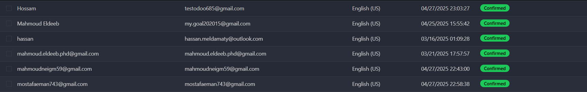
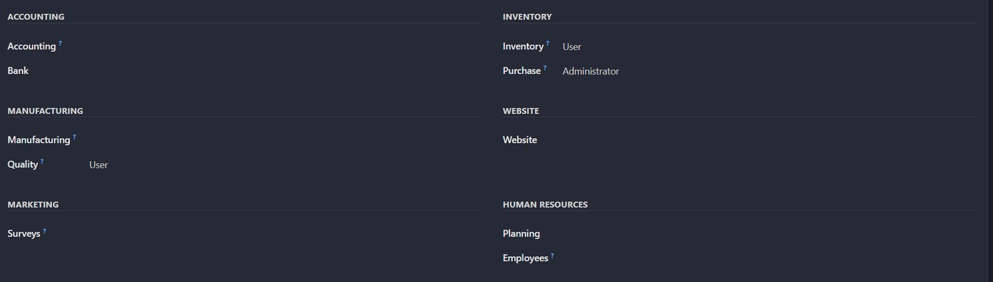
USERS CREATION
After creating Database we need to create users with right permissions.

Slide 6
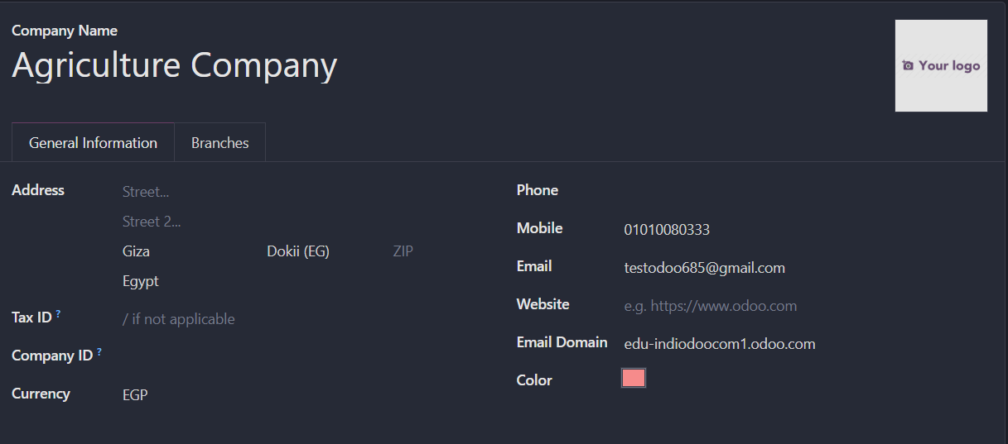
ADD USED LANGUAGE
The stakeholder requested we add EN-AR languages for the system
SETUP COMPANY DETAILS

Slide 7
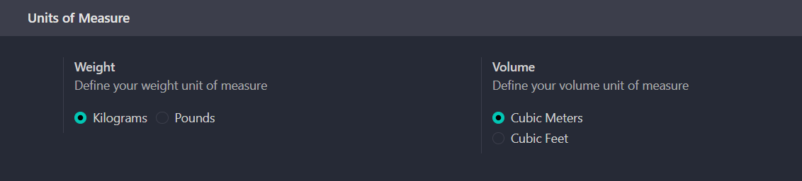
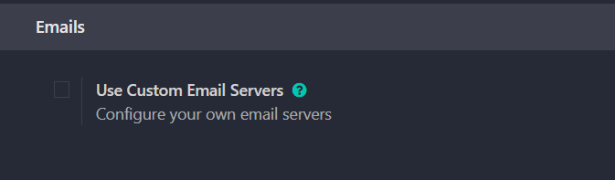
APPLY UNITS OF MEASURE
EMAIL SETTINGS

Slide 8
ACCOUNTING MODULE

Slide 9
ESSENTIAL INFORMATION
Country | Egypt
Taxes Used | 14 % (sales and purchase )
Stock Valuation | Automatic Accounting
Inventory Costing Method | FIFO
Accounting Method | Anglo-Saxon Accounting
Currencies | Multi-currencies
Charts of Accounts | Assets , Liabilities, Expenses.Revenues
Opening Balance & Cost centers &payment Terms & Follow-up Levels

Slide 10
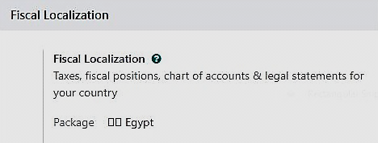
FISCAL LOCALIZATION

Slide 11
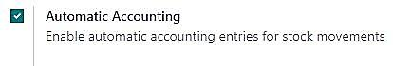
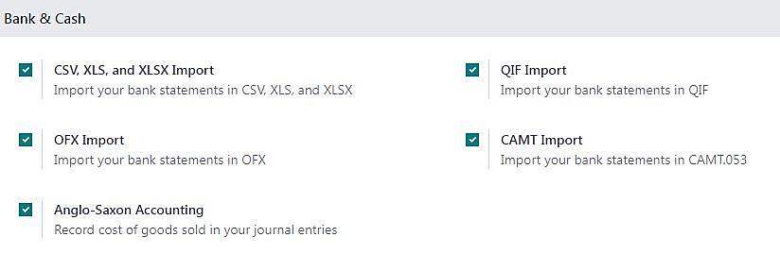
STOCK MOVEMENTS

Slide 12
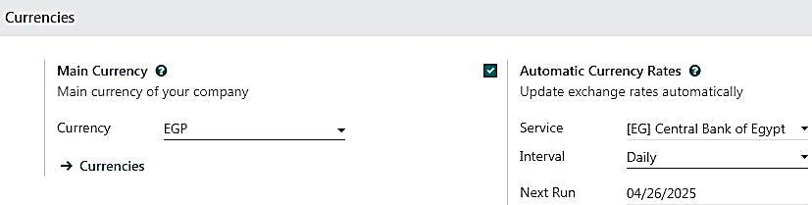
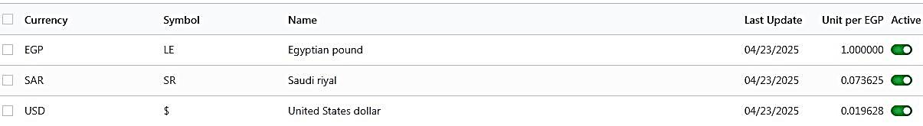
USED CURRENCY

Slide 13
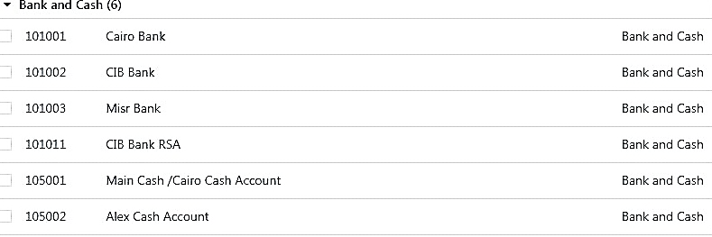
CHARTS OF ACCOUNTS
Upload charts of account from Excel
Export Update Import

Slide 14
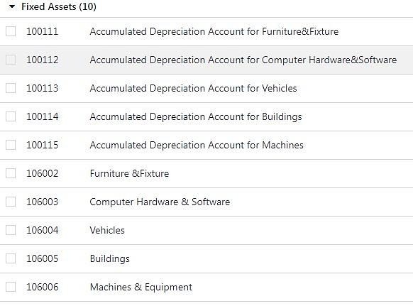

Slide 15
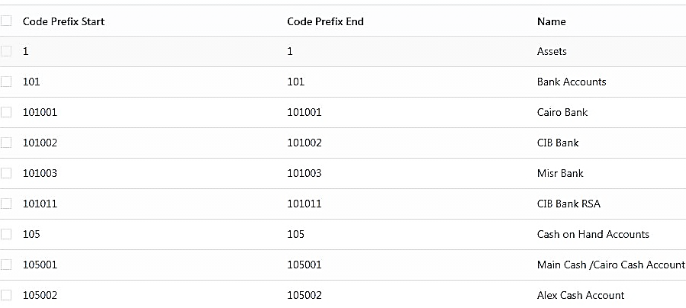
Account Groups/ Main Accounts

Slide 16
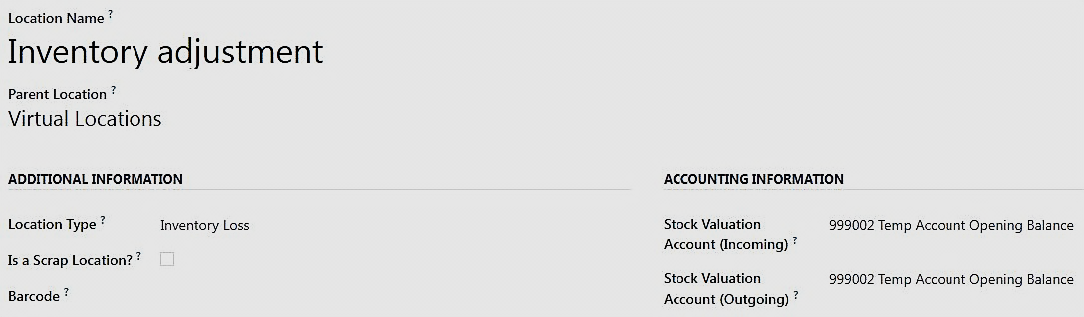
OPENING BALANCES
Using Inventory Adjustment location
حساب مؤقت لرفع المخزون ويغير بعد الرفع

Slide 17
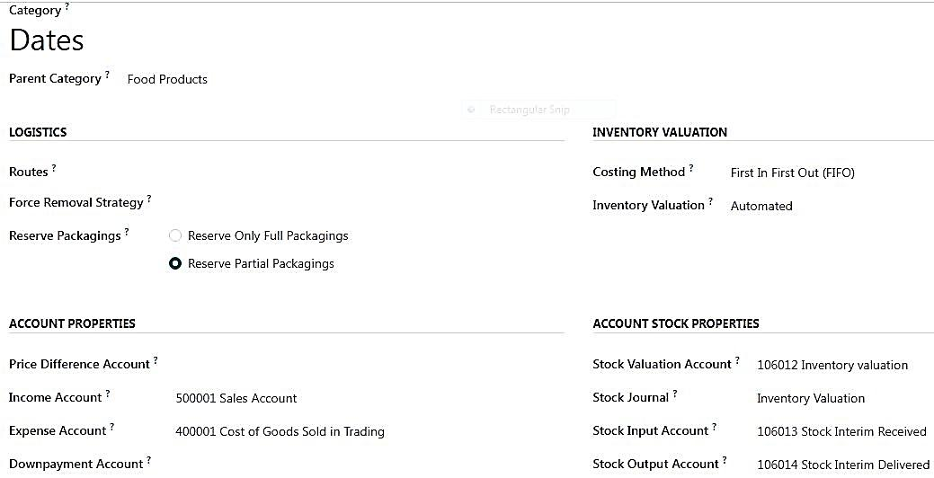
Creating Product Category

Slide 18
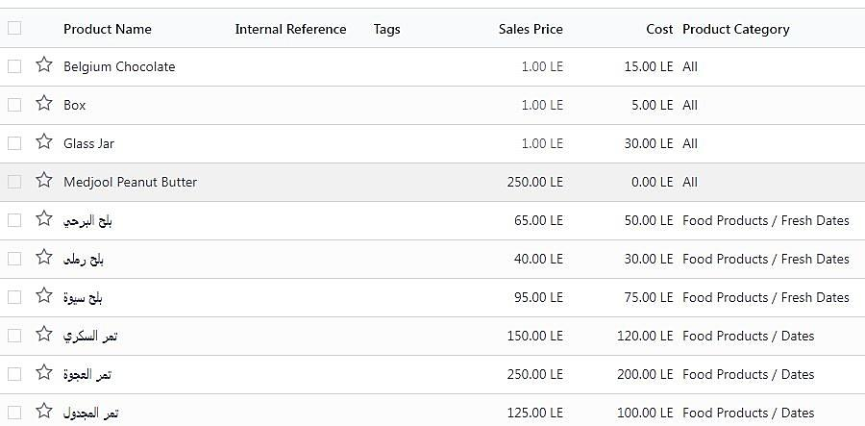
Upload Products by Excel Sheet

Slide 19
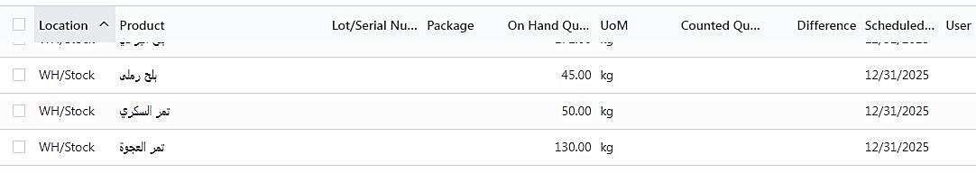
Upload Product Counted Quantity form physical Inventory by Excel sheet then apply All

Slide 20
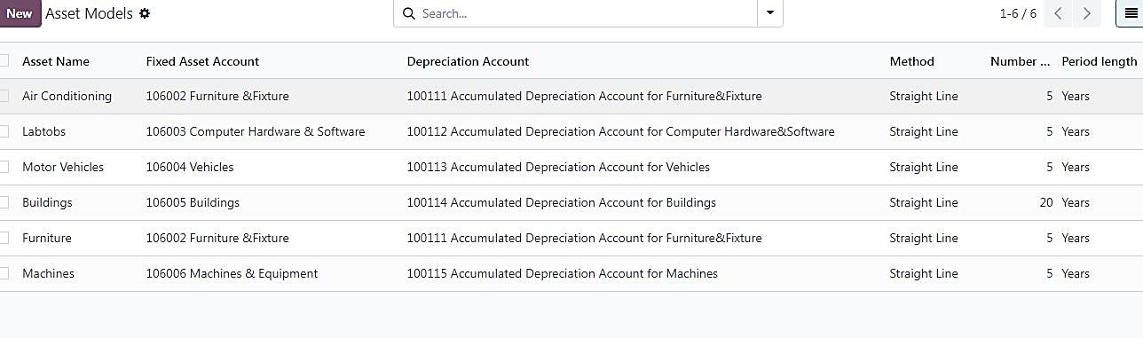
Creating Asset Model

Slide 21
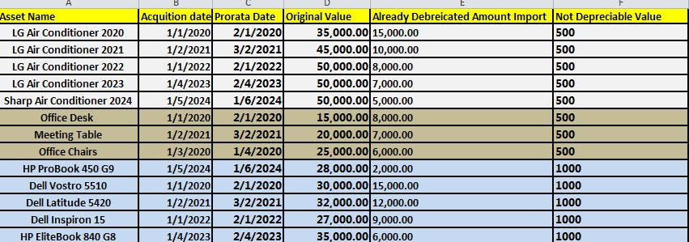
Upload Fixed Assets by Excel sheet

Slide 22
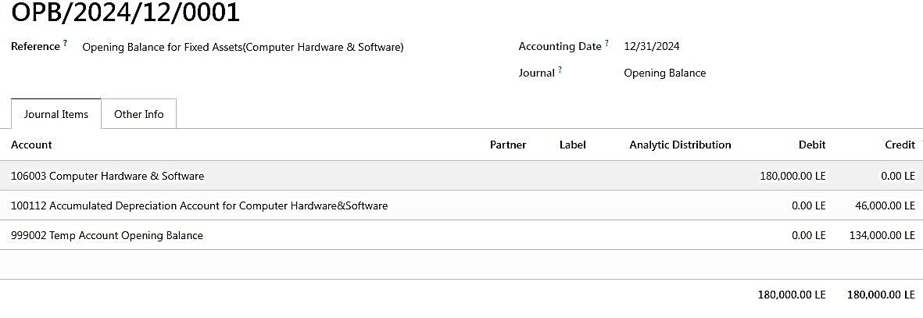
Creating Journal Entries
الأصل
مجمع الإهلاك
حساب مؤقت

Slide 23
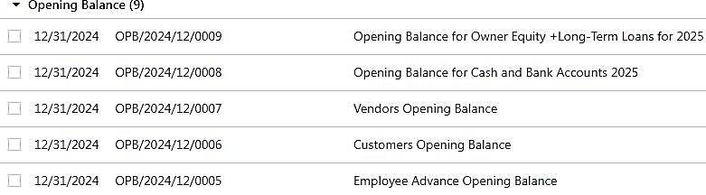
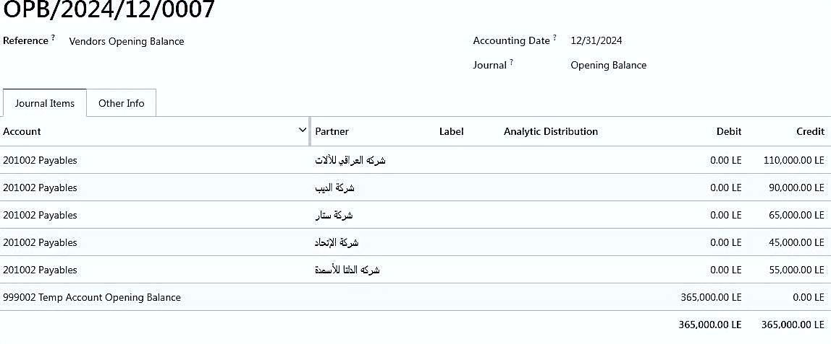
Upload Other Accounts

Slide 24
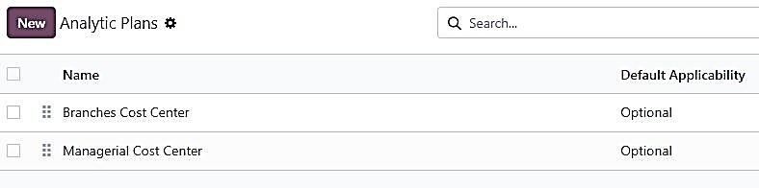
Analytic Accounting /Cost Centers

Slide 25
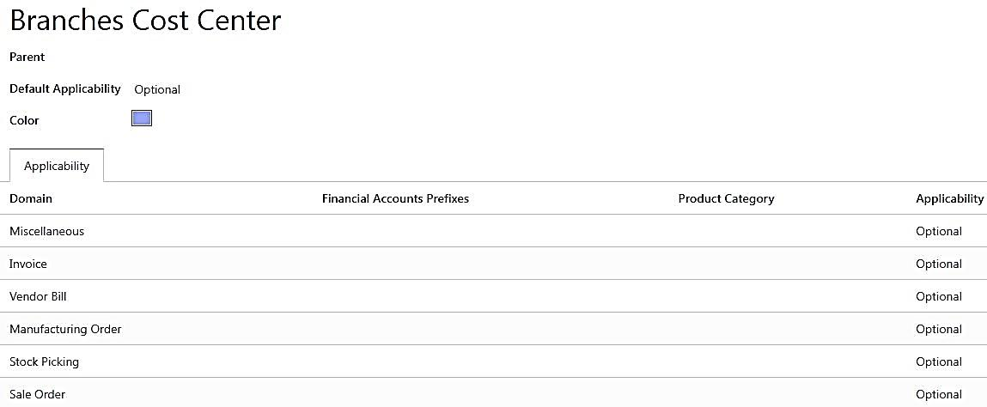
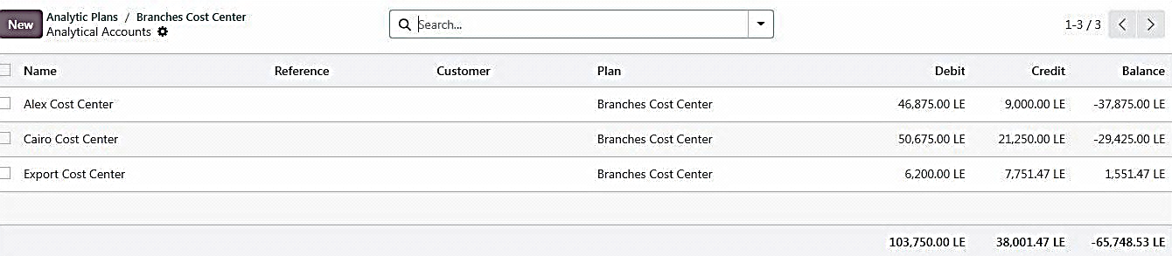
Creating Analytic Accounts
Balance of Cost Centers

Slide 26
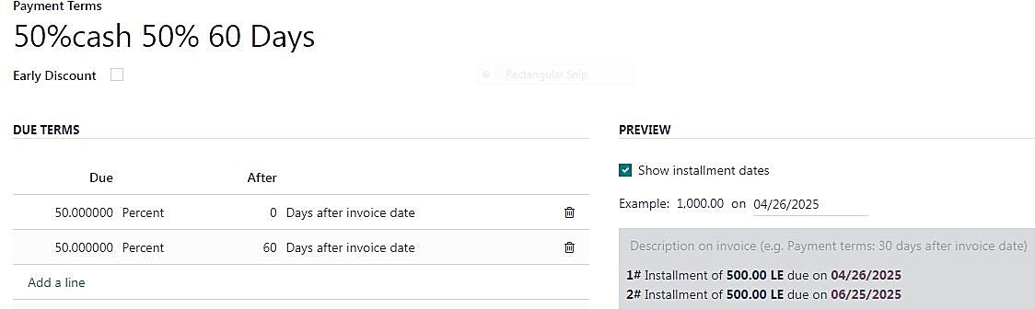
Cases OF Daily Operation and Features of Using Odoo Customer Invoice with payment terms

Slide 27
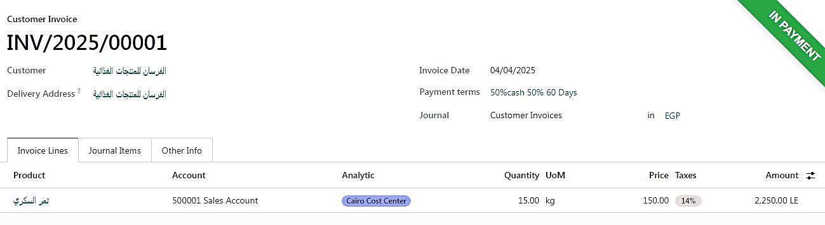
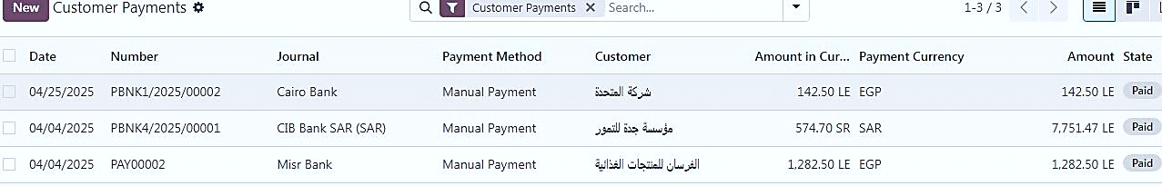
Customer Invoice with payment

Slide 28
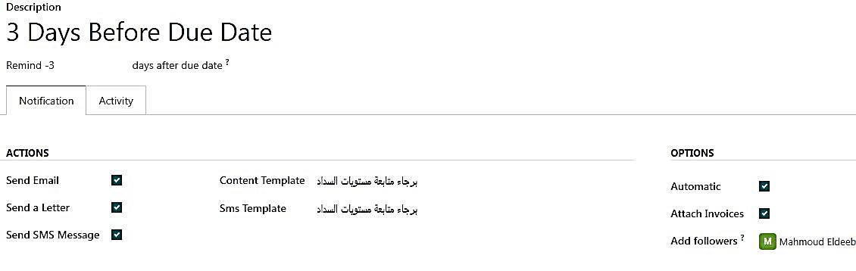
Follow-up Levels

Slide 29
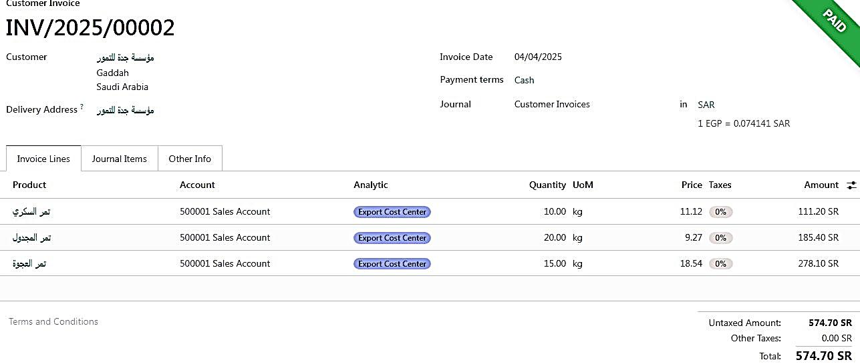
Customer Invoices with Foreign Currency (SR)

Slide 30
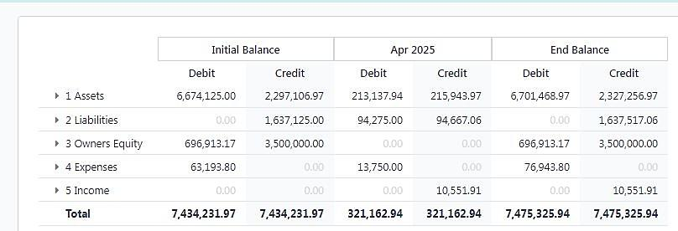
Reporting
Trial balance

Slide 31
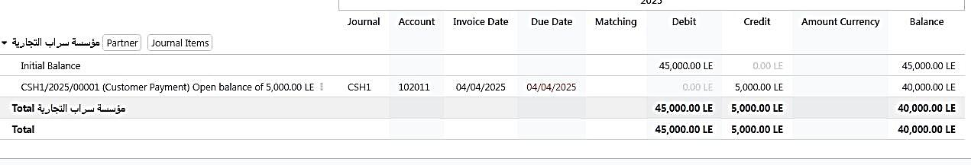
Partner Ledger
رصيد بداية المدة
دفع
رصيد حالى

Slide 32
INVENTORY MODULE

Slide 33
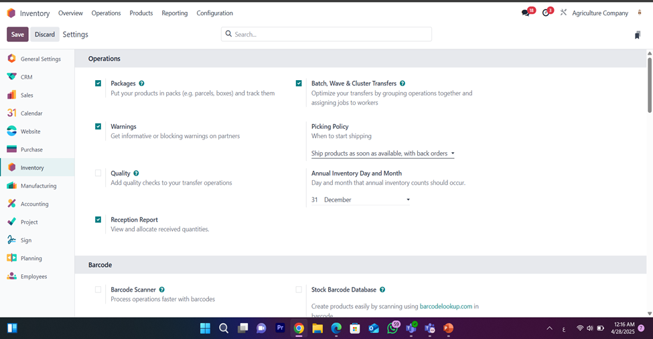
OPERATIONS SETTINGS

Slide 34
OPERATIONS SETTINGS
Packages
Function:
The process involves placing products into designated packages, such as parcels or boxes, and tracking them across various stages of the supply chain. Each package is monitored individually to ensure full traceability and control.
Reason for Selection:
This method enhances product organization and ensures precise tracking throughout the logistics process. By dividing shipments into individual packages, the company minimizes errors, improves operational efficiency, and facilitates smoother shipping and storage management.

Slide 35
OPERATIONS SETTINGS
Batch, Wave & Cluster Transfers:
Function:
Enhancing transfer operations by grouping tasks together and distributing them efficiently among workers.
Reason for Selection:
This method organizes operations to make them smoother and distributes tasks more effectively among employees, which speeds up the transfer process and minimizes wasted time.
Additional Feature – Picking Policy:
Defines when the shipment process should begin either once all products are available or when part of the order is ready — while closely managing backorders.

Slide 36
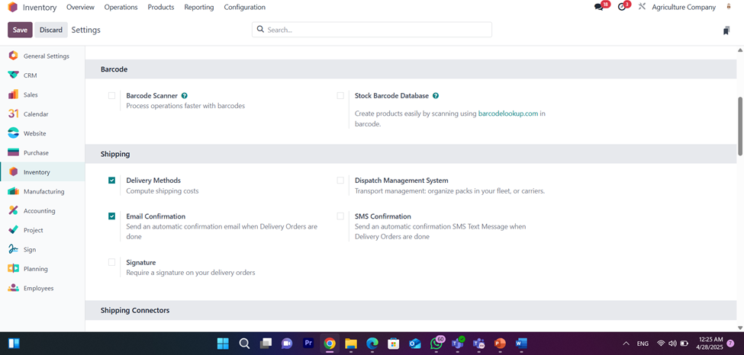
SHIPPING SETTINGS

Slide 37
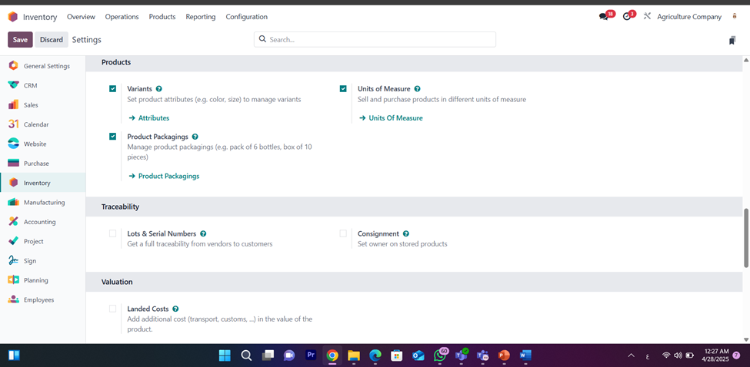
PRODUCTS SETTINGS

Slide 38
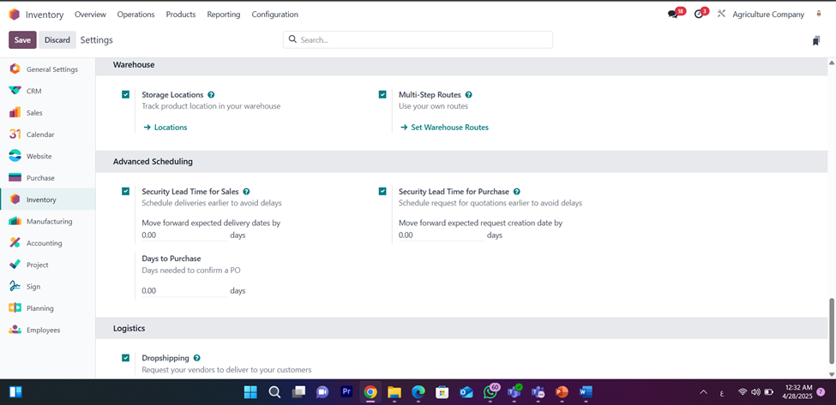
WAREHOUSE SETTINGS

Slide 39
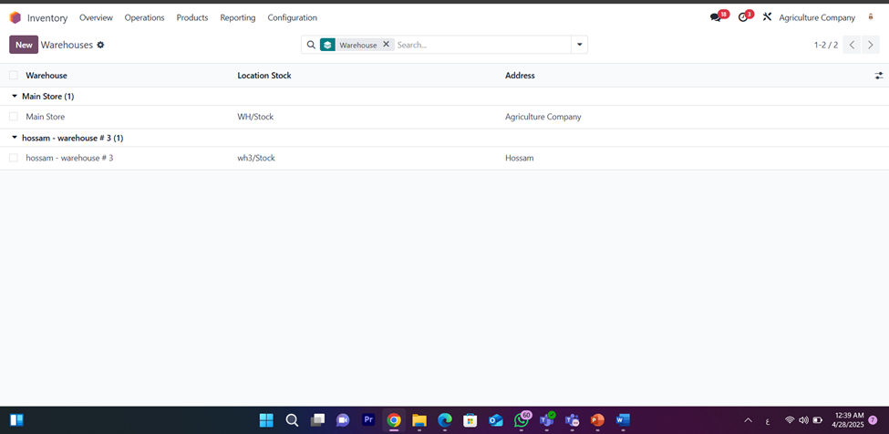
WAREHOUSE SETTINGS

Slide 40
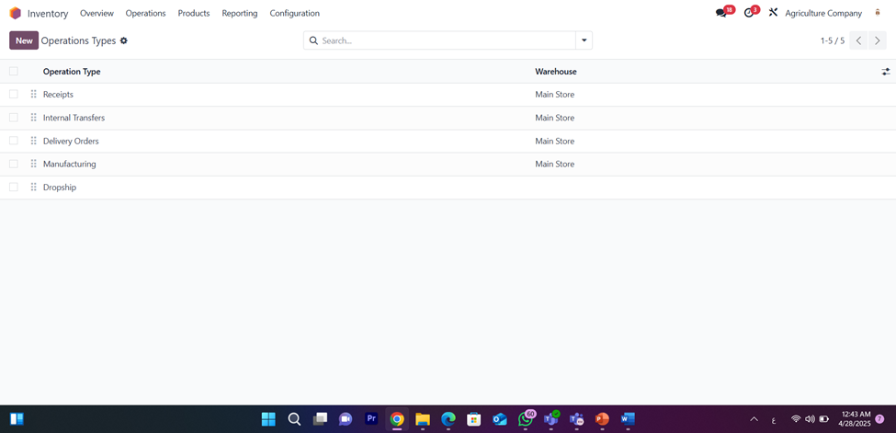
OPERATIONS TYPE

Slide 41
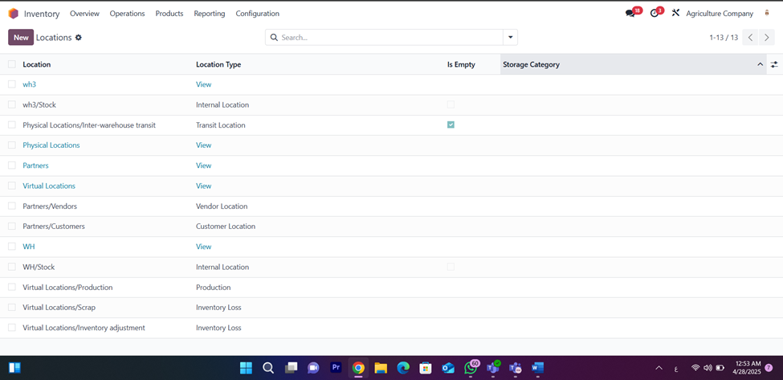
LOCATIONS SETTINGS

Slide 42
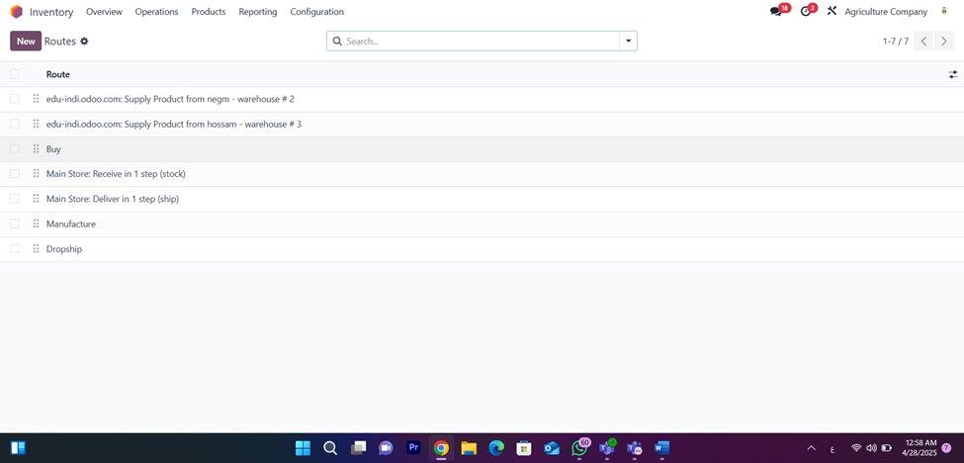
ROUTES SETTINGS

Slide 43
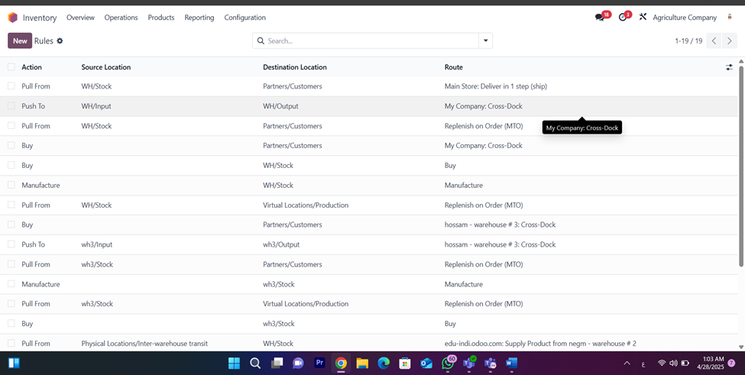
RULES SETTINGS

Slide 44
PURCHASING MODULE

Slide 45
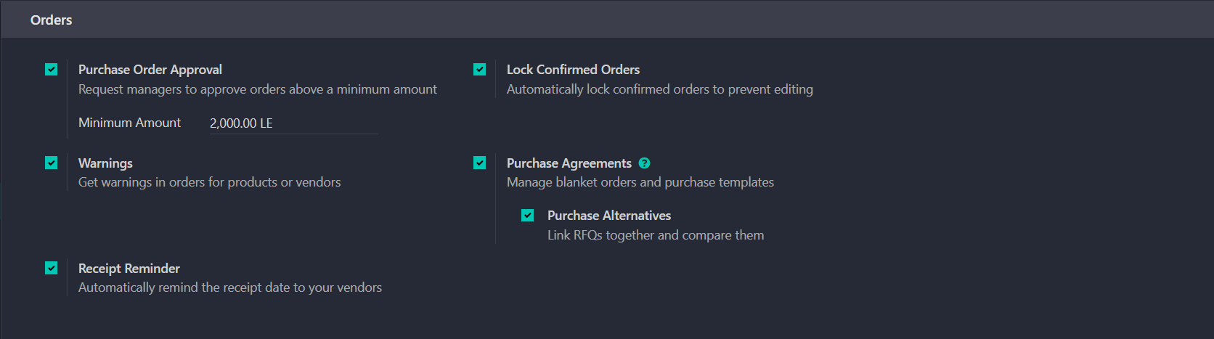
PURCHASING SETTINGS

Slide 46
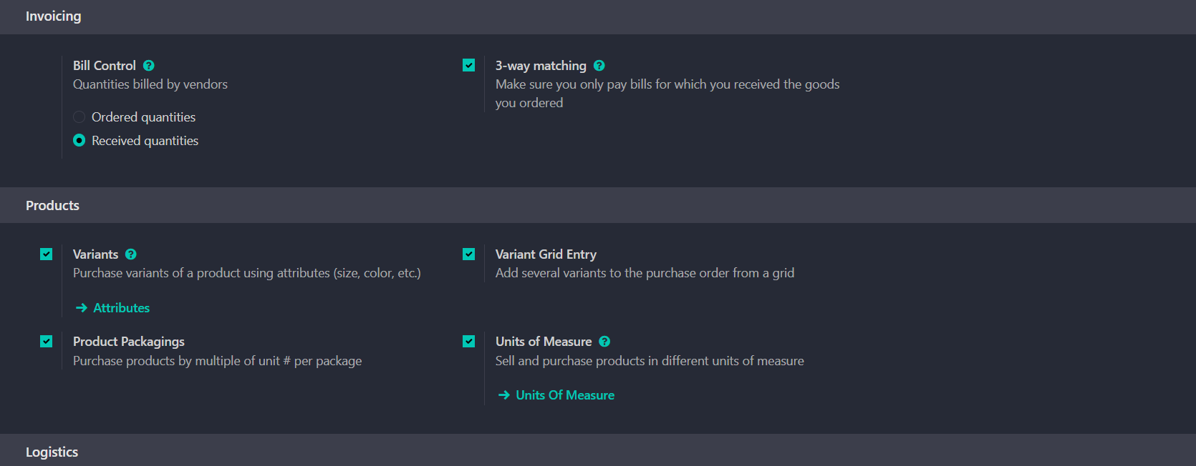
PURCHASING SETTINGS

Slide 47
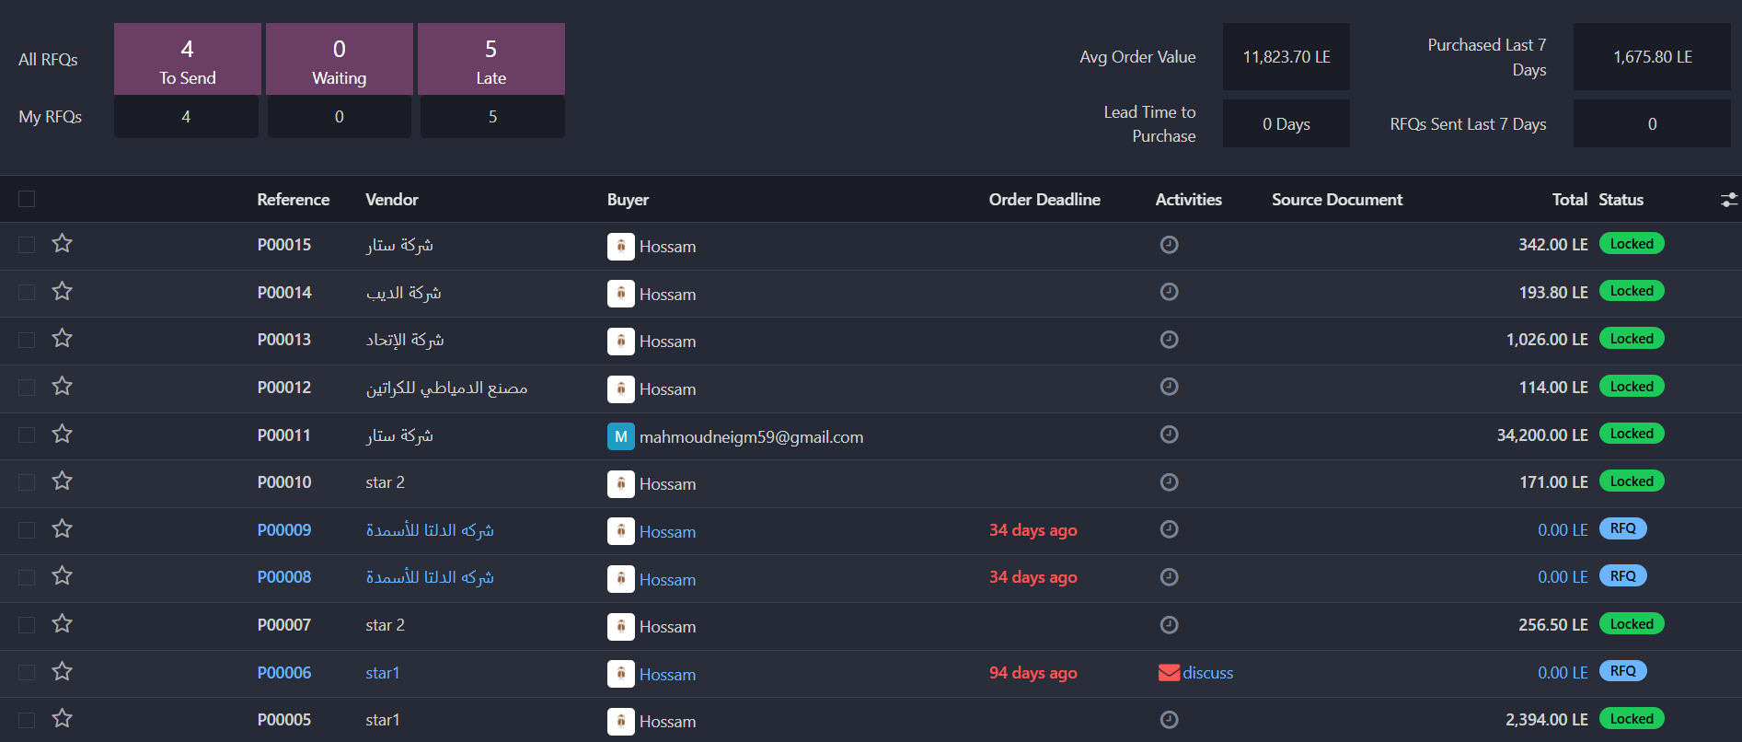
PURCHASING TRANSACTIONS

Slide 48



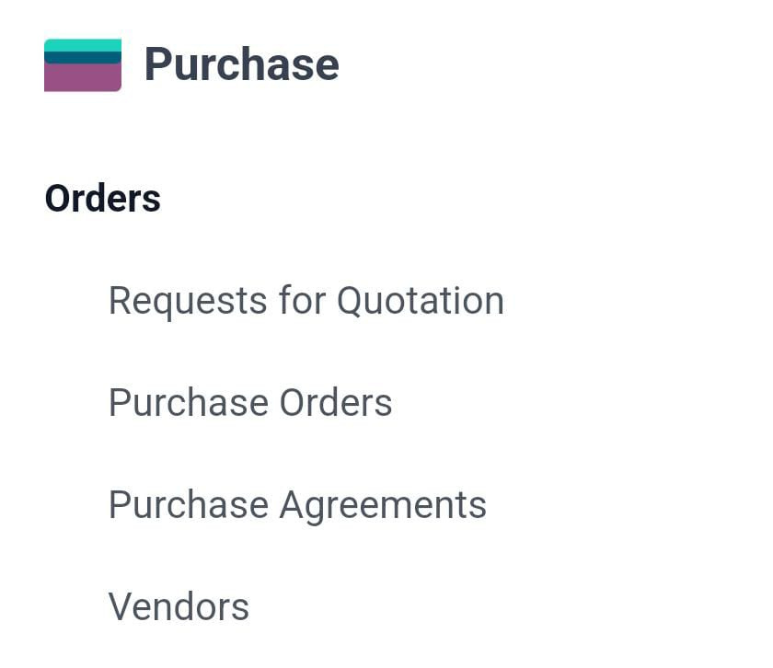


PURCHASING SETTINGS
Create a Request for Quotation (RFQ)
Initiate an RFQ based on internal needs or low inventory levels
Send RFQs to Multiple Vendors
Distribute the RFQ to various suppliers to receive competitive quotations
Review and Select the Best Offer
Evaluate the received quotations and choose the most suitable offer
Confirm the Purchase Order (PO):
Approve and validate the selected offer by confirming the purchase order.
Receive and Record the Goods.
Receive the ordered products and log them into the system.
Convert the Purchase to a Vendor Bill.
Generate a vendor bill and forward it to the accounting department for payment processing.

Slide 49
CRM MODULE

Slide 50
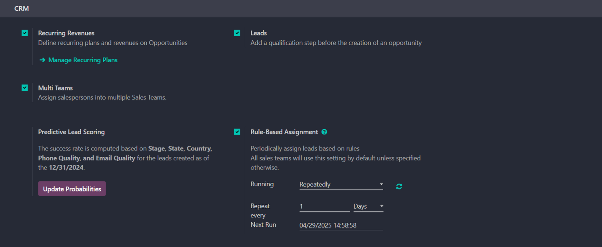
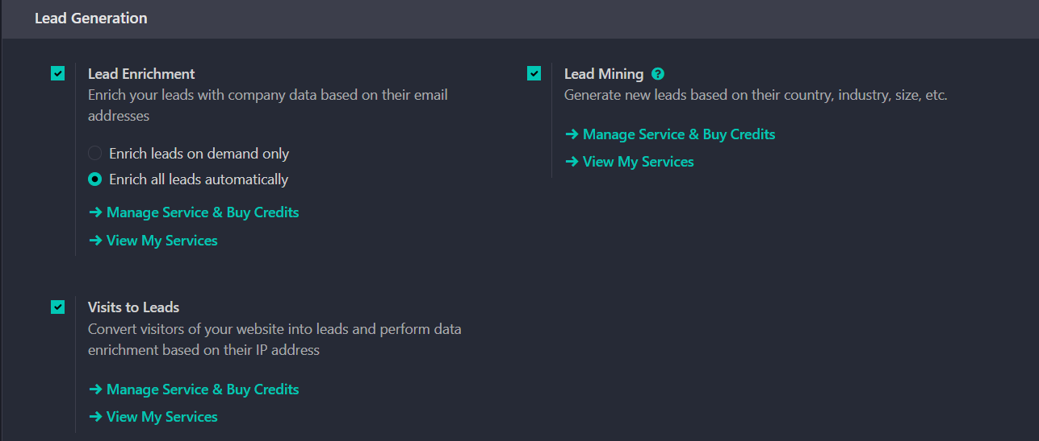
CRM SETTINGS

Slide 51
SALES MODULE

Slide 52
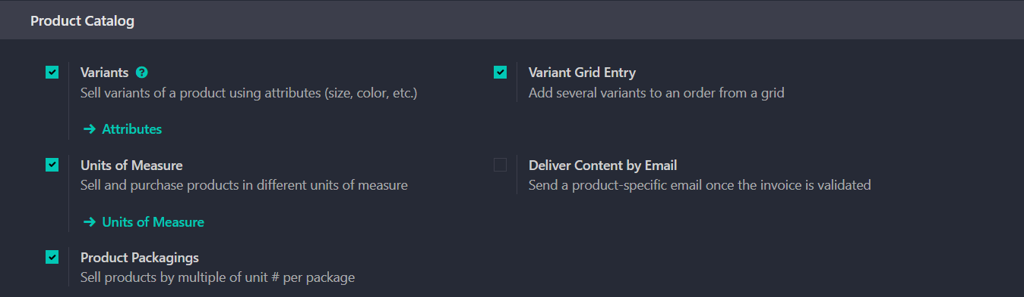
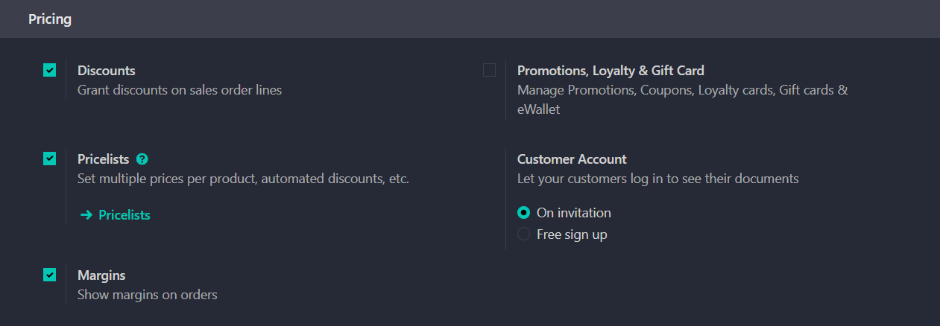
SALES SETTINGS

Slide 53
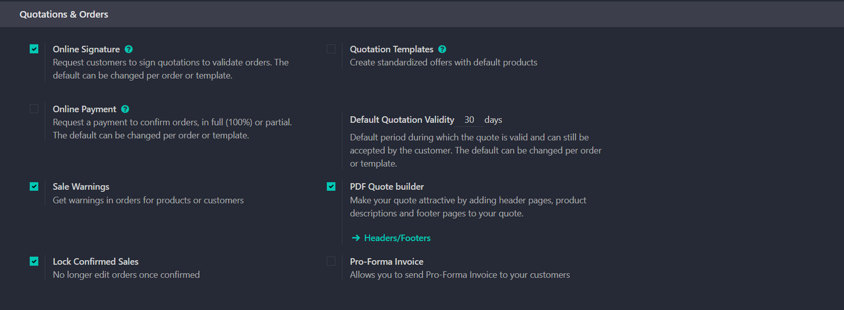

SALES SETTINGS

Slide 54
MANUFACTURING MODULE

Slide 55

MANUFACTURING SETTINGS

Slide 56

MANUFACTURING ORDER

Slide 57

BOM

Slide 58

UNBILD ORDER

Slide 59

SCRAP ORDER

Slide 60









TEAM MEMBERS
MAHMOUD ELDEEB
MAHMOUD NEGM
ROMANY MOFED
HOSSAM MOHAMED
HASSAN ELDAMATY
EMAN
MOSTAFA

